Slide 1


TITANIC SURVIVAL PROJECT
PRESENTED BY-
OWAIS IMAM
1811981213

Slide 2
AIM
In this project, we look at how machine-learning techniques can be used to predict Titanic survivors. We attempt to predict the survivors of a small test group of 418 using a dataset of 891 individuals with features such as sex, age, and passengers class. Compare and contrast various machine learning techniques such as Logistic Regression ,Random Forest , Naïve-Bayes, SVM, KNN, and AdaBoost analysis.

Slide 3
DATA SET
Kaggle website, we found the data we needed for our project. For our training package, we were given 891 passenger samples, along with labels indicating whether or not the passenger survived. We were given the passenger's passenger class, name, sex, age, number of siblings/spouses aboard, number of parents/children aboard, ticket number, fare, cabin embarked, and port of embarkation for each passenger.
The data must first be cleaned before it can be used for some form of data analytics. Any values in the table are missing . It is necessary to manage a dataset. Missing values are replaced with random samples from current age in attributes like Age, Cabin, and Embarked. We discovered that one passenger with passenger id 1044 has a missing fare in the column Fare.
In the first level, we will conduct exploratory data analysis for our dilemma. dataset for exploratory data processing is investigated in order to determine the characteristics that affect the survival rate. The data is thoroughly examined in order to establish a connection between each attribute and survival.

Slide 4
Machine Learning Models
Logistic Regression
Random Forest
When the dependent variable is dichotomous, logistic regression is the right method to use (binary or categorical).Logistic regression is used to describe and illustrate the relationship between one dependent binary variable and one or more nominal, ordinal, interval, or ratio-level independent variables.
It is used to solve binary classification problems; some real-world examples include spam detection (predicting whether an email is spam or not), and data mining . Predicting whether a given mass of tissue is benign or malignant in health, and predicting whether a given user will buy an insurance policy or not in marketing.
The supervised classification algorithm is the random forest algorithm. Essentially, the algorithm creates a forest with a large number of trees. The more trees in the area, the higher the precision of the results.
The number of true positive and false positive (event that causes false prediction and subject result is also false) in the Random Forest algorithm.

Slide 5
Approach/Method
The use of machine learning algorithms is being used to predict which passengers survived the Titanic's sinking. The predictions will be based on factors such as ticket price, age, gender, and social class. Predictive analysis is a method of determining significant and useful patterns in broad data sets using statistical methods.
Survival is predicted using machine learning algorithms based on various combinations of features.
The aim is to use exploratory data analytics to mine different information from the dataset available and to determine the impact of each area on passenger survival by using analytics between each field of the dataset and the “Survival” field. Machine learning algorithms are used to make predictions for newer data sets.
The data will be analysed using algorithms, and the accuracy will be tested. The accuracy of various algorithms is compared, and the best performing model is recommended for predictions.

Slide 6
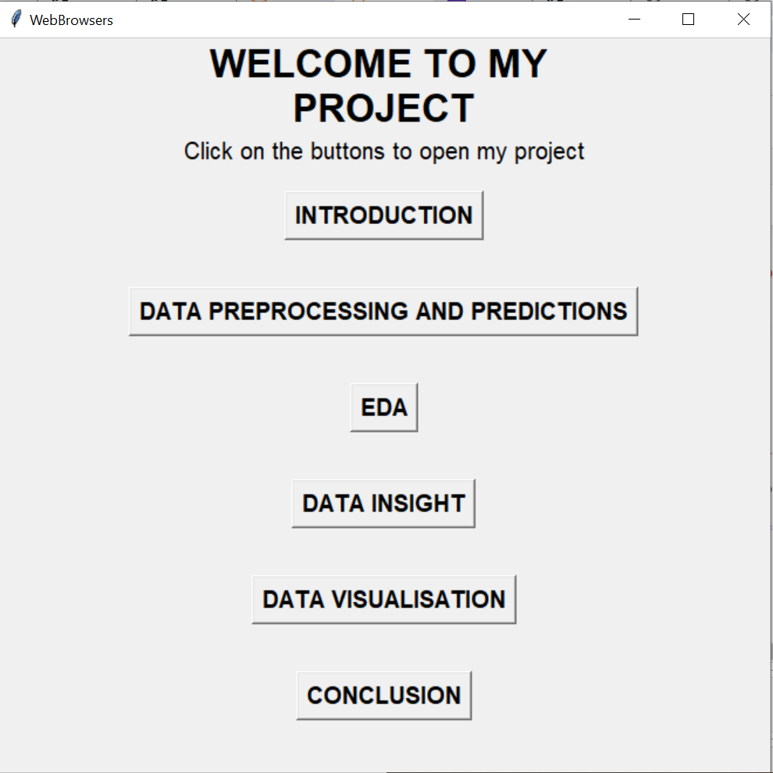
GUI IMPLEMENTATION

Slide 7
TKINTER WEB PAGE IS USED TO SHOW GIVEN PROJECT IN MORE INTERACTIVE WAY.
GOOGLE COLAB WORK HAVE BEEN LINKED WITH THE USER INTERFACE.
BY CLICKING ON EACH BUTTON USER IS REDIRECTED TO MY GOOGLE COLAB WORK SAVED ON MY DRIVE.

Slide 8
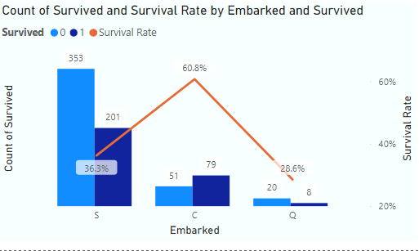
DATA VISUALISATION

Slide 9
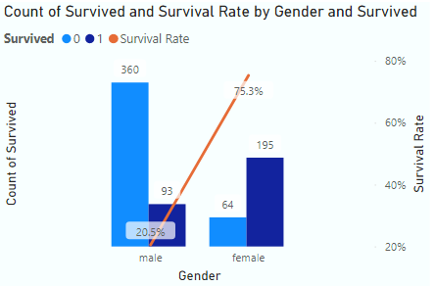

Slide 10
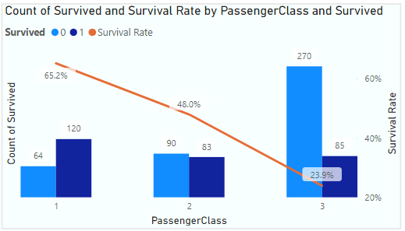

Slide 11
CONCLUSION
When doing data analysis, the first step is to clean the data. Exploratory data analytics aids in the comprehension of the dataset and the relationships between the attributes. EDA is used to determine the relationship between the dataset's features . This is accomplished by the application of various graphical techniques. ggplot and histograms were used in the example above . Some assumptions and evidence are drawn as a result of using EDA.
It can be shown that the female survival rate is very high while the male survival rate is very low. To determine the size of a passenger's family, we combined the parch and sibsp columns. We discovered that when the family size ranges from 0 to 3, the survival rate rises. When a family grows to more than three members, however, the survival rate drops.
Higher the fare higher the survival rate.

Slide 12
FUTURE WORK
This project entails data analytics and machine learning implementation. This project work can be used as a starting point for learning how to apply EDA and machine learning . With the support of newer libraries like shiny in R, the concept can be expanded in the future to create more sophisticated graphical user interfaces. If the value of an attribute is modified, an interactive page can be created.

Slide 13


Slide 14


